Slide 1
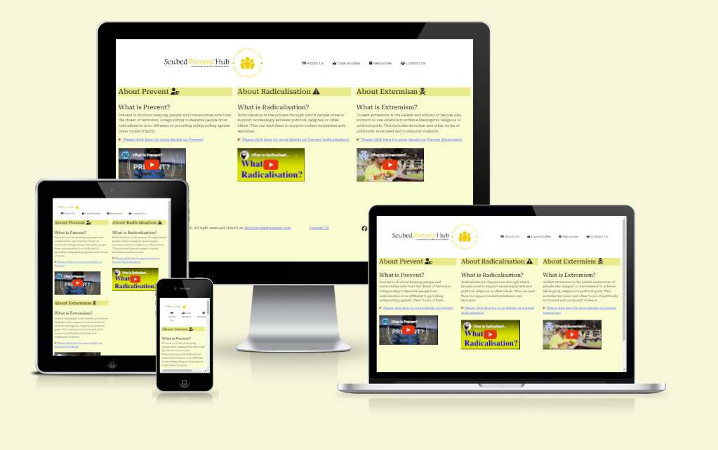

Prevent Awareness Website
ScubedPreventHub
Dev1- Steve Benton Dev2- Suba Suresh Dev3 - Suraj Rajendran
Notes:
Team Lead: Hi everyone. We are TEAM NAME composed of myself, Dev2 and Dev 3. We’d like to talk about our project PROJECT NAME TECHSTACK(HTML/BOOTSTRAP/JS/CSS/API) & TAGLINE

Slide 2
Planning & Design
Ideation
UX Design
Technologies
To build a site to inform and support the community in Prevent to mitigate Radicalisation and Extremism.
Aimed at general public with tailored content for Educators, Community Leaders and Parents.
User Stories in GitHub, MoSCoW
Intuitive UI - header menu bar.
Responsivity - Bootstrap
Accessibility - alt text
Interactivity - links and forms
Languages & Frameworks:
Balsamic Wireframing tool
GitHub Project
GitHub Version Control
Bootstrap 5.3 front end toolkit.
Font Awesome Images
Notes:
Team Lead discusses the following 1 minute

Slide 3
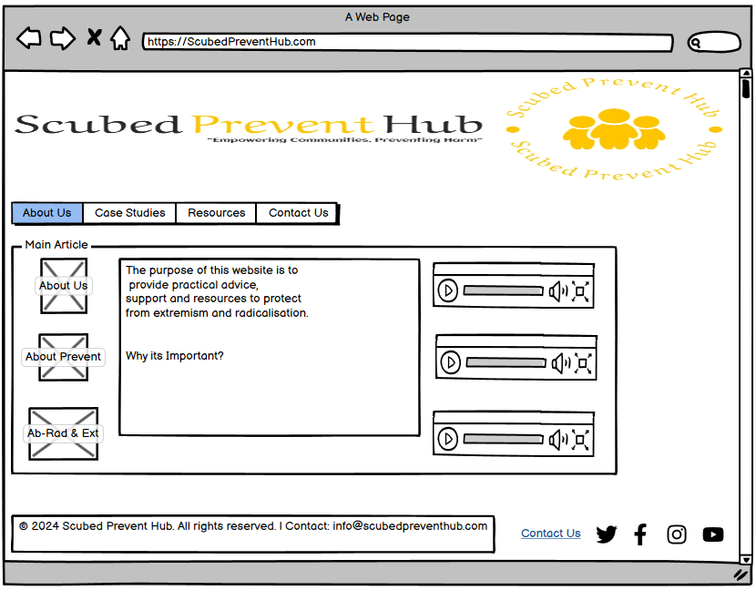
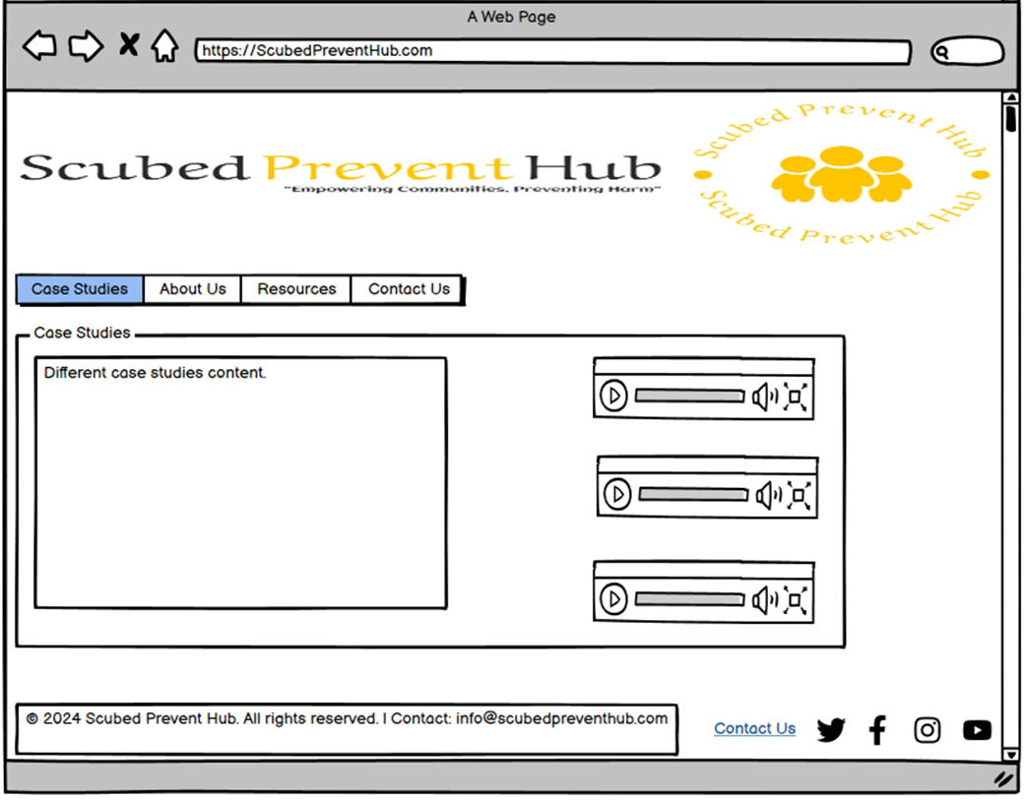
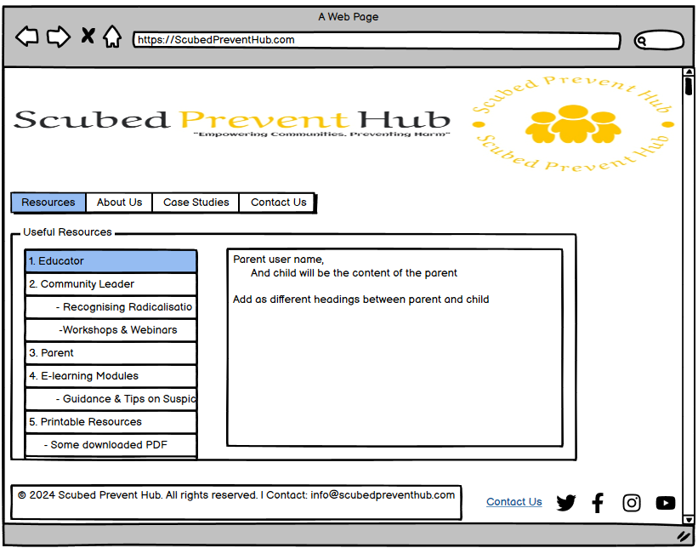
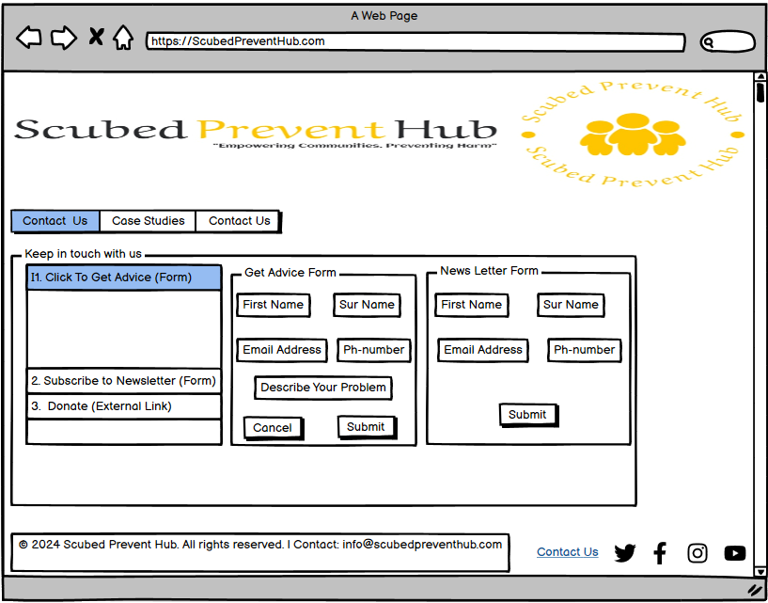
Wireframe Design
Notes:
Team Lead discusses the Project board 30 seconds! Introduces Dev 2

Slide 4
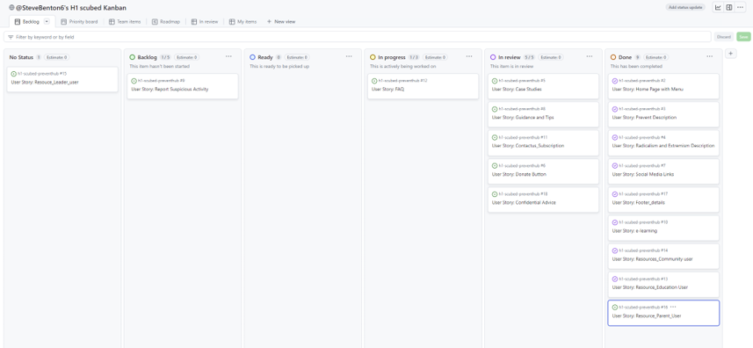
Project Board
Number of User Stories - 17 Assigned Tasks - 15 MoSCoW Prioritisation AGILE (MVP) - 8 Project Backlog - 2
Notes:
Team Lead discusses the Project board 30 seconds! Introduces Dev 2

Slide 5
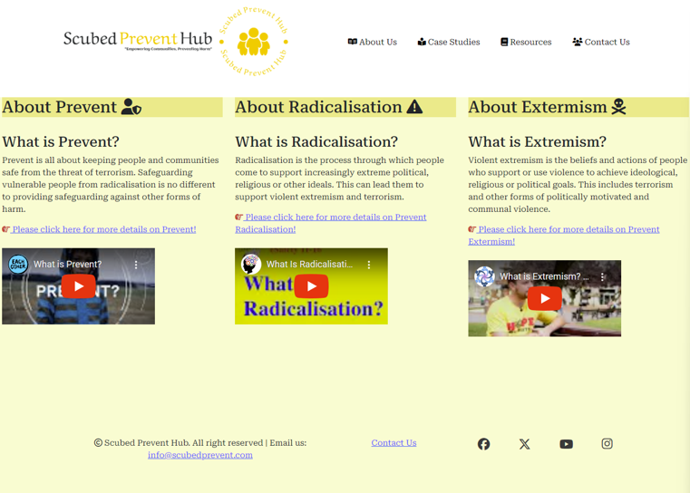
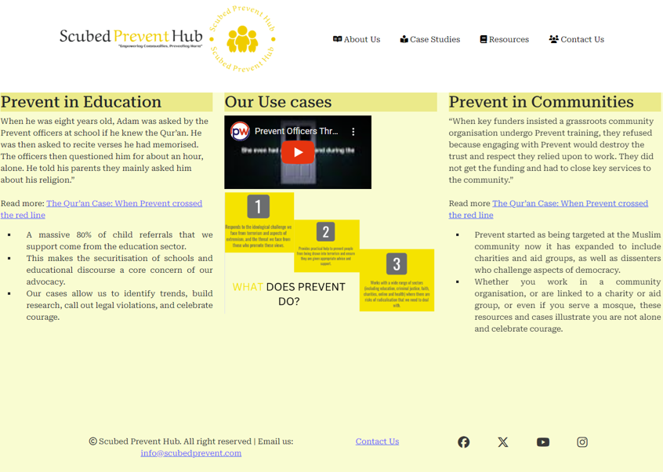
Features
About Us
Case Studies
Notes:
Dev 2 Discuss the MAIN FEATURES OF THE APP AT A HIGH LEVEL 1 minute

Slide 6
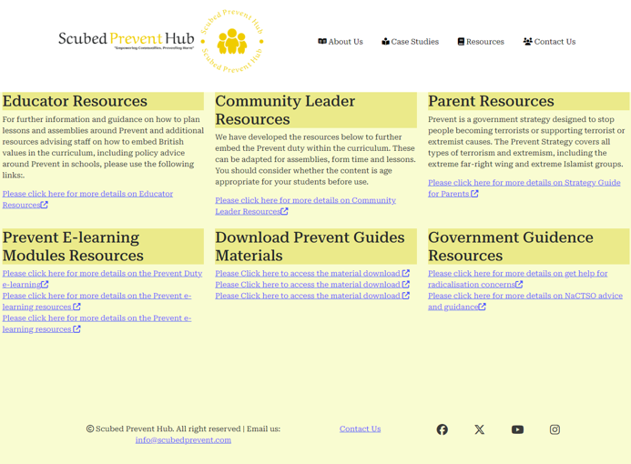
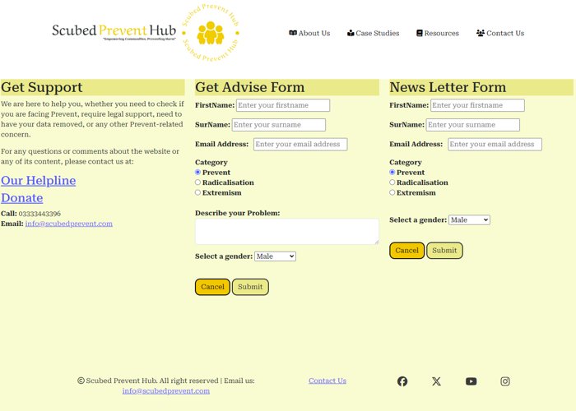
Features
Resources
Contact Us
Notes:
DEV 2 Discusses secondary and tertiary features in this slide. Introduces DEV 3

Slide 7
Deployed Project
Deployed Link: https://stevebenton6.github.io/h1-scubed-preventhub/
Notes:
Dev 3 opens the link to the deployed project (Mention deployment process via github pages)and exhibits responsiveness, additional features and user experience.1 minute

Slide 8
Documentation, Testing & Version Control
GitHub Repository: https://github.com/SteveBenton6/h1-scubed-preventhub
Notes:
Dev 3 then opens Repo, and exhibits README touching on testing and deployment

Slide 9
Collaboration & Outcomes
Outcomes
Development Problems
Collaboration
Summary
Happy with initial product (given code merging challenges)
Need to be better able to manage code merging activities and use better best practice - to refocus time on user stories, coding and README.
Code merging challenges
Solved problems and created initial site through good team collaboration.
Jointly solved many problems - technology and content.
Small fixes to complete
Good group dynamic when we got going.
Good team satisfaction.
We applied much of what we had learned so far - user stories, wireframe, bootstrap
A positive experience.
Notes:
All 3 Devs could maybe take a card each here.

Slide 10
Q&A
Notes:
Quick q&a 1 question each from the judges and any questions from the group.

Slide 11
Known Issues To Resolve:
Footer not sticking to bottom
Hover color for footer social Media links
Checking all Alt Descriptions for Accessibility
Finalise ReadMe
Validate Content
Background Image
External Links Open In new Tabs - Fixed
Highlight In Menu For Current Page - Fixed
Cancel Button on Contact Us - Fixed

